Slide 1

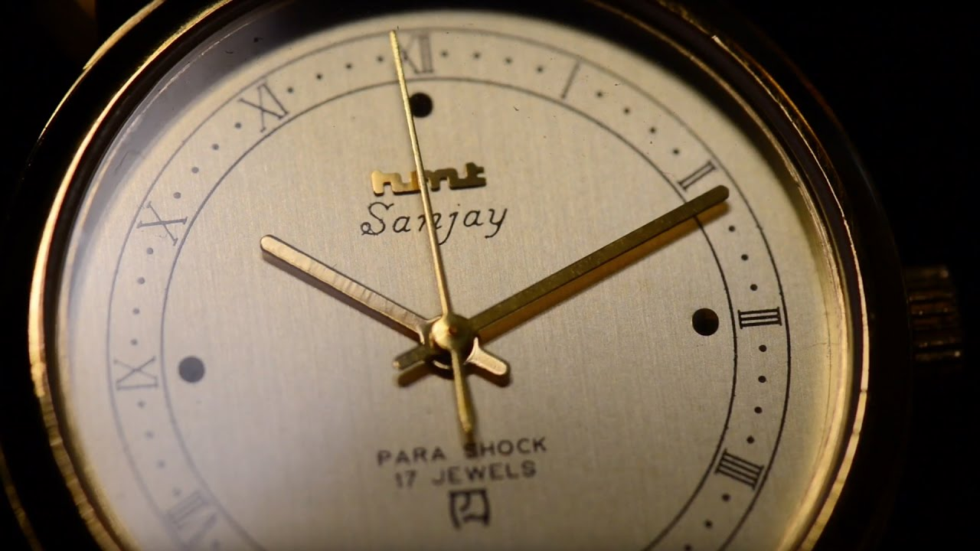
Debacle of HMT Watches Ltd: The Microeconomic Issues
GROUP-9
19169- SHREYAS C
19170- SHUBHAM THAKUR
19171- SINDHUJA SISTA
19172- SOORAJ JAIN M
19173- SOWMYASHREE S
19174- SUHAS M S

Slide 2
Hindustan Machine Tools
1953
Incorporated in 1953 by the Government of India as a machine tool manufacturing company.
1961
In 1961 with the support of Japan’s Citizen Watch Company started watch division in Bangalore.
1981
Enjoyed monopoly till 1981.

Slide 3
1961 | Factory set up at Bangalore in collaboration with Japan’s M/S Citizen Watches
1972 | The second unit was set up at Bangalore to manufacture automatic day date watches the third unit came into existence at Srinagar
1975 | Manufacturing facility setup at Tumkur to manufacture quartz analog watches
1994 | Started incurring losses
2000 | According to the turnaround plan of the Union Government, the HMT Watch Business group was restructured as HMT Watches Limited, a subsidiary of HMT Limited
2006 | A revival plan mooted by the board for the reconstruction of public sector enterprises
2014 | Board for the reconstruction of public sector enterprises suggested its closure
2016 (January) | Cabinet Committee on Economic Affairs, Government of India, gave the approval for the closure of HMT Watches

Slide 4
Competition Emerges
In 1981,quartz watches became very prominent
Hyderabad Allwyn Limited, entered into the Indian market with the support from a Japanese company named Seiko.
in1984, Titan entered into the Indian market as the third watch company after HMT and Allwyn.
Within a short span of time, Titan appeared to be a challenger forcing the market leader HMT to rethink its strategies.

Slide 5
In 1991,introducing policies of liberalization, privatization and globalization so as to save the country from economic turmoil.
Entry of global players like Casio, Swatch, Citizen, etc
In 1994,HMT registered a loss of US$14 million.

Slide 6
Reasons behind HMT’s Downfall

Slide 7
Centralized Decision-making
Being a state-owned enterprise, the decision-making power was vested in the government.
During many occasions, manufacturing decisions could not be timely which caused the loss of sales and hence financial losses.
Factors like shortages of working capital, attrition of trade channel and the high cost of borrowing adversely affected the company.

Slide 8
Lack of Research and Development
HMT confined itself to produce basic utility watches only and did not pay adequate attention to manufacture technologically advanced products.
Most of its designs were the copies of some foreign brands.
No special focus was put on research and development (R&D).

Slide 9
Weak Organizational Culture
The company management did not show any entrepreneurial spirit.
The employees, on the other hand, remained crippled with the old mindset and presumed themselves only as job seekers.
When the company entered into a phase of poor financial health, the HMT employees were not even paid their wages.
At the time of the announcement of the closure, HMT Watches had more than 920 employees who were forcibly given the ‘voluntary’ retirement.

Slide 10
Less Control over Retail Trade
Hindustan Machine Tools had a limited chain of distributors.
Hindustan Machine Tools watches were available from Defence Canteen Store Depots (CSDs) and a few designated wholesalers.
Slowly, HMT lost its command over retail price and subsequently it lost control on the trade completely.

Slide 11
Inability to Understand Changing Consumer Preferences
Hindustan Machine Tools used to conduct occasional consumer surveys to gain an understanding of the consumer preferences. However, the company rarely used these survey results for making changes in the product line or formulating appropriate marketing strategies.
Hindustan Machine Tools missed on a very crucial aspect of the industry, that is, a watch is no longer considered as a time-keeping machine, it is becoming more of a fashion accessory for both men and women.
HMT failed to understand the mindset of aesthetics-seeking consumers, which hit it hard.

Slide 12
Inadequate Advertisement
Hindustan Machine Tools did not pay much attention to promotional strategies.
As a market leader, HMT appeared to be complacent and very few aggressive advertisement campaigns were released by it for augmenting the visibility to its products.

Slide 13
RECOMMENDATIONS
Start a new subsidiary for QUARTZ segment and target it to lower end market.
Innovation in advertisements discount, sponsoring events.
Attracting the young generation through media.
Invested in R&D and come up with new varieties with attractive design.
Collaboration with retail showrooms for newly launched models.
Exclusive outlets.

Slide 14


THANKYOU

